Slide 1
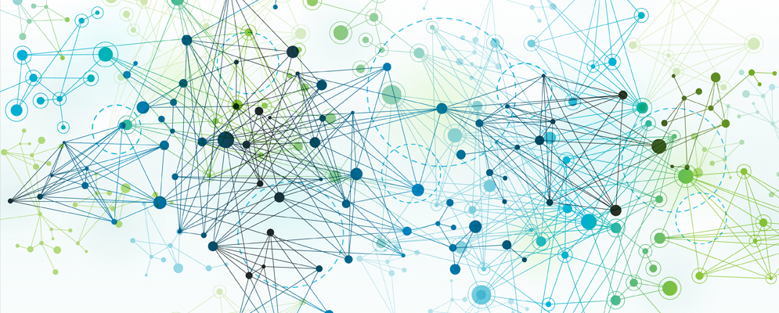
Python for AI and Machine Learning
ML/AI Process & Concepts
Part 1
Marilson Campos
UCSC Extension - 2022

Slide 2

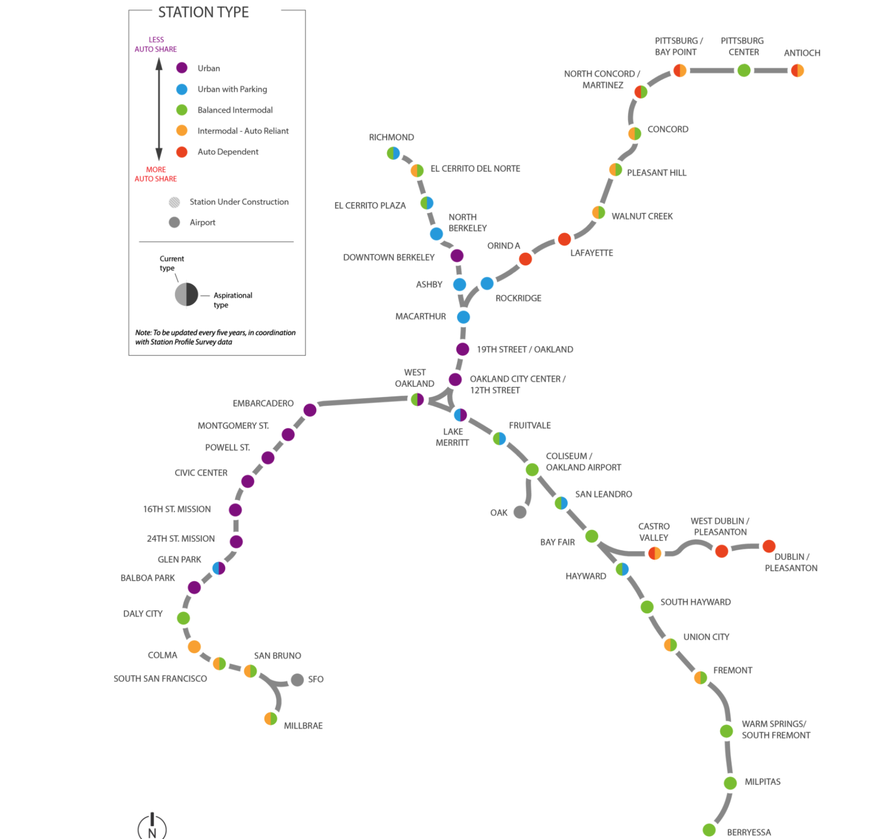
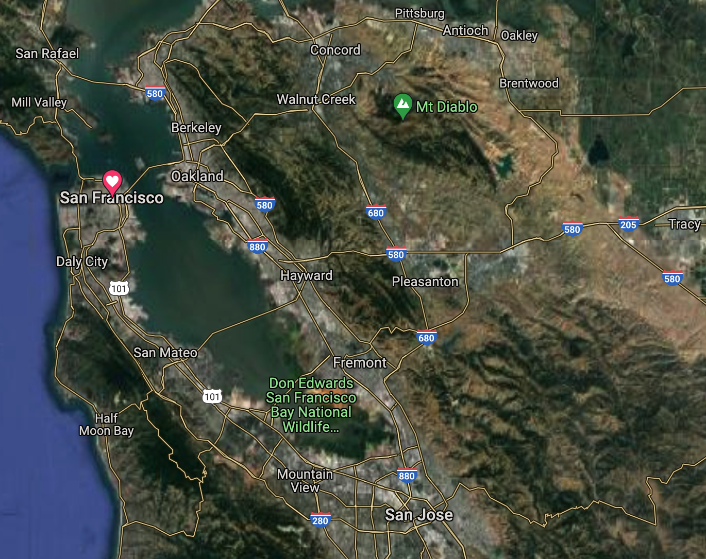
Why do we need models?

Slide 3
Computational Models
Optimization Models
Objective function maximize/minimize
Solutions limited by a set of constraints.
Simulation Models
Simulate the execution of real cases using randomizations
Statistical Models
Machine Learning models.

Slide 4
Problem-Solving: Traditional Vs AI/ML
Traditional problem solving
Start from Requirements
Derive Rules/Sequence of Commands
Test program against the set of known examples.
AI/ML problem solving
Start from Data
Select ’model type’ and possibly the features to use.
Create pipeline to extract knowledge from data.
Validate ‘learnings’ against new data

Slide 5
ML Model Example 1 – Linear Regression
Assumes the answer is a linear combination of input values.
Example:
Predict rent amount based on:
# of bedrooms (beds)
# of bathrooms (baths)
Neighborhood ‘score’: number from 1 to 5 (zone)
After training, we could have learned the following formula:
Rent = (342 * beds) + (159 * baths) + (250 * zone)

Slide 6
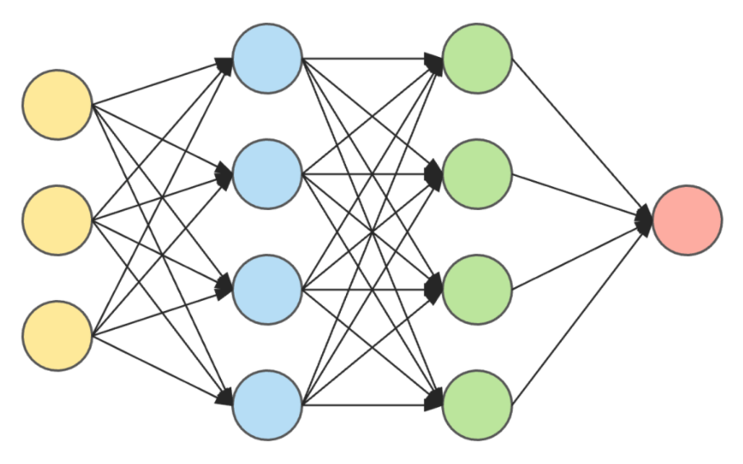
ML Model Example 2 – Neural Network
Model contains several ‘layers’ of ‘neurons interconnected.
Example:
Recognize the zip code handwritten in a letter.

Slide 7
Terminology - 1
Model (in ML/Ai) = The mathematical construct we use to learn and make inferences about data.
Target Variable = The answer(‘output’) of a model.
Predictor = The inputs used to produce an output.
Feature = A data element or some derivation of it used as a predictor.

Slide 8
Terminology - 2
Cost function = A function that defines the ‘price’ of each error the model makes. The goal is to minimize the average price we pay for errors.
Model Parameter = An internal value of a model that is unknown and will be ‘learned’ during model training.
Model Hyperparameter = A parameter that the modeler provide to the model. Example: Number of trees to use in tree-based models.

Slide 9
Goal of Model Training
Use data ‘examples’ to build an artifact (model) that captures the ‘general’ trends of that data.
Generalization is the process of extracting this underlying knowledge that goes beyond the ‘current data set’

Slide 10
Bias / Variance Trade off
Bias: A model with high bias is more ‘stubborn’ and pays less attention to the dataset. It tends to oversimplify (underfit = adapt less)
Variance: A model with high variance pays too much attention to the data. A single record can shift the model wildly. It tends to over complicate (overfit = adapt more)

Slide 11
Find the sweet spot in the Bias/Variance blend.
Underfit
Overfit
To much
Bias
To much
Variance
Right balance
Generalization

Slide 12
Bias / Variance Trade off
How to control Bias/Variance
Option 1: Pick models that are flexible depending on the problem.
Ex: linear regression vs. tree-based models
- Option 2: Regularization
Regularization allows you to put a price on model complexity. So simpler models are preferred unless the errors are a lot larger.

Slide 13
ML Model Lifecycle
1
Data Acquisition
2
Exploratory Data Analysis
3
Model Selection
Data Hygiene
4
Feature Engineering
Model Training
5
6
Model Performance
Monitoring
Model
Validation
7
Learnings
Feedback
Deployment

Slide 14
Ensemble Models
- Ensemble ML models are models that build a set of ML models internally and use some form of voting to determine the result.
1. Bagging is ensemble algorithm that selects random subsets of a dataset and builds models for each of them and finally combine the results.
2 Random Forest is an extension of Bagging that select subsets of rows and subsets of columns and build models that are later combined.
3. Boosting is another ensemble algorithm that build models in sequence and the input of the next sequence is the ‘error’ (delta) from the previous one.

